Slide 1
Wazuh Plus Plus - Advanced Persistent Threat detection using AI
20k-0358 Aleena Khan
19k-1495 Abdullah
19k-1413 Siadat Ali
Supervisor: Ms. Yusra Kaleem
Co-supervisor: Jawwad shamsi

Slide 2
Introduction
Purpose: Enhancing cyber threat detection using AI-driven analytics integrated with SIEM systems.
Need for Innovation: Addressing the limitations of traditional threat detection methods with advanced AI techniques.
Project Overview: Implementing a hybrid model combining machine learning and rule-based systems.
Impact: Expected to significantly improve the detection rates and response times for emerging threats.

Slide 3
Literature Review
AI in Cybersecurity: How AI transforms threat detection and system response capabilities.
Research Gap: Identifying the need for integration of a hybrid AI model with existing SIEM solutions.
Following are the papers that we did literature review on: 1. Phishing Attacks Detection: A Machine Learning-Based Approach
2. Detection of Phishing Attacks: A Machine Learning Approach
3. Identification of Phishing Attacks using Machine Learning Algorithm

Slide 4
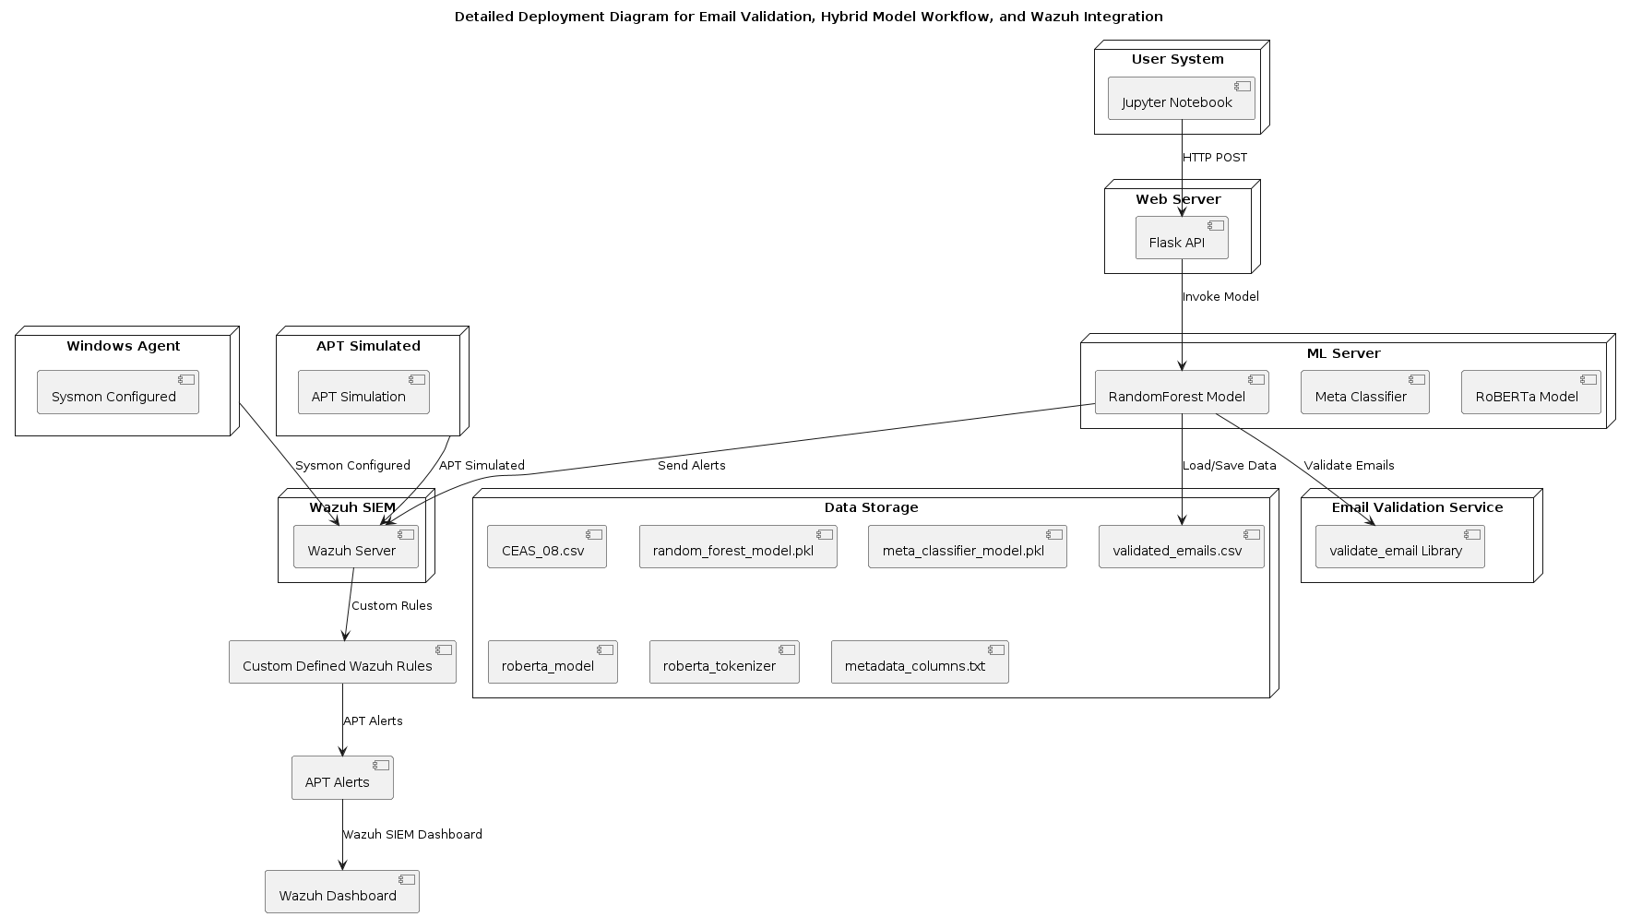
System Architecture

Slide 5
Methodology
Data and Features: The study uses the "CEAS_08.csv" dataset with email data, including features like sender's details, date, and URLs. Key features selected for phishing detection are sender's domain, time of sending, email validity, and URL presence.
RoBERTa and Embeddings: RoBERTa generates embeddings for email subject and body to capture their meaning effectively, enhancing the model's performance.
Classifier Integration: The hybrid model combines Random Forest for metadata features and RoBERTa embeddings using logistic regression. This integrated model is deployed via a Flask API for real-time phishing detection.
Custom Rule Definition: Custom rules are developed for APT detection in Wazuh Plus Plus Activities, aiming to identify APT-related patterns and Indicators of Compromise (IOCs).

Slide 6
Integration with Wazuh
Custom Rules Implementation: How AI predictions are integrated into Wazuh as custom rules.
Alert Management: Process of alert generation and handling in Wazuh.
Operational Impact: Enhancements in operational threat management.

Slide 7
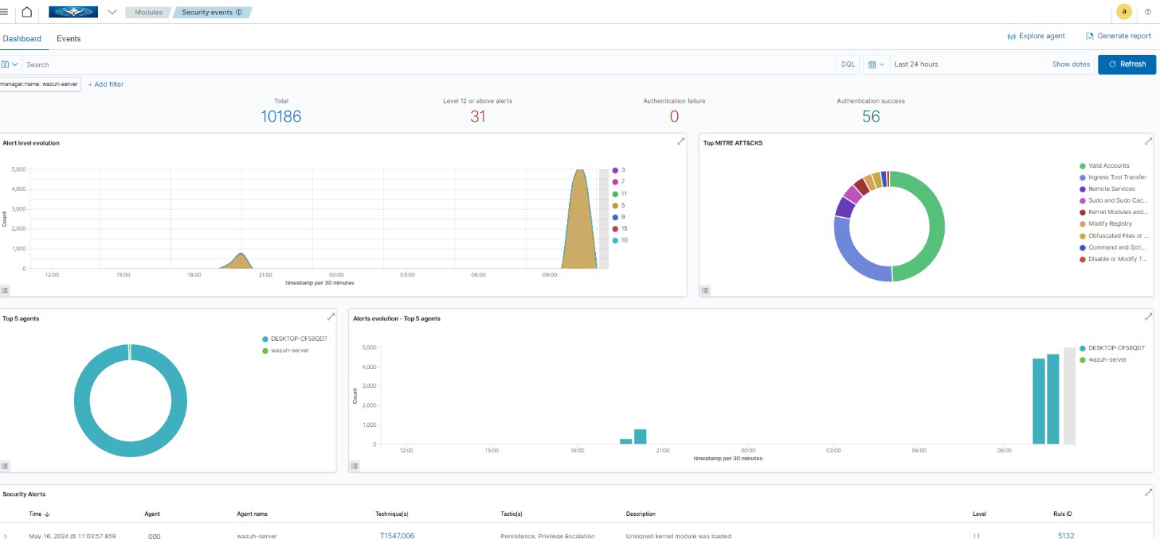

Slide 8
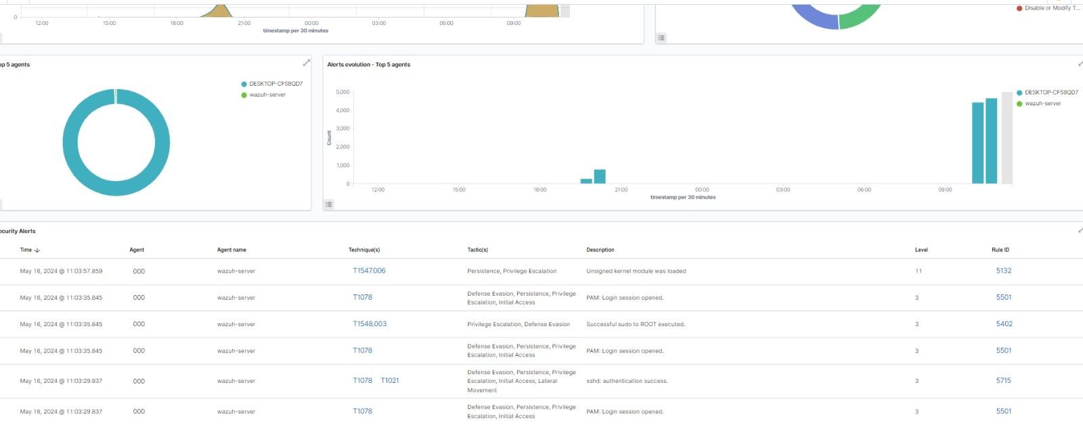

Slide 9
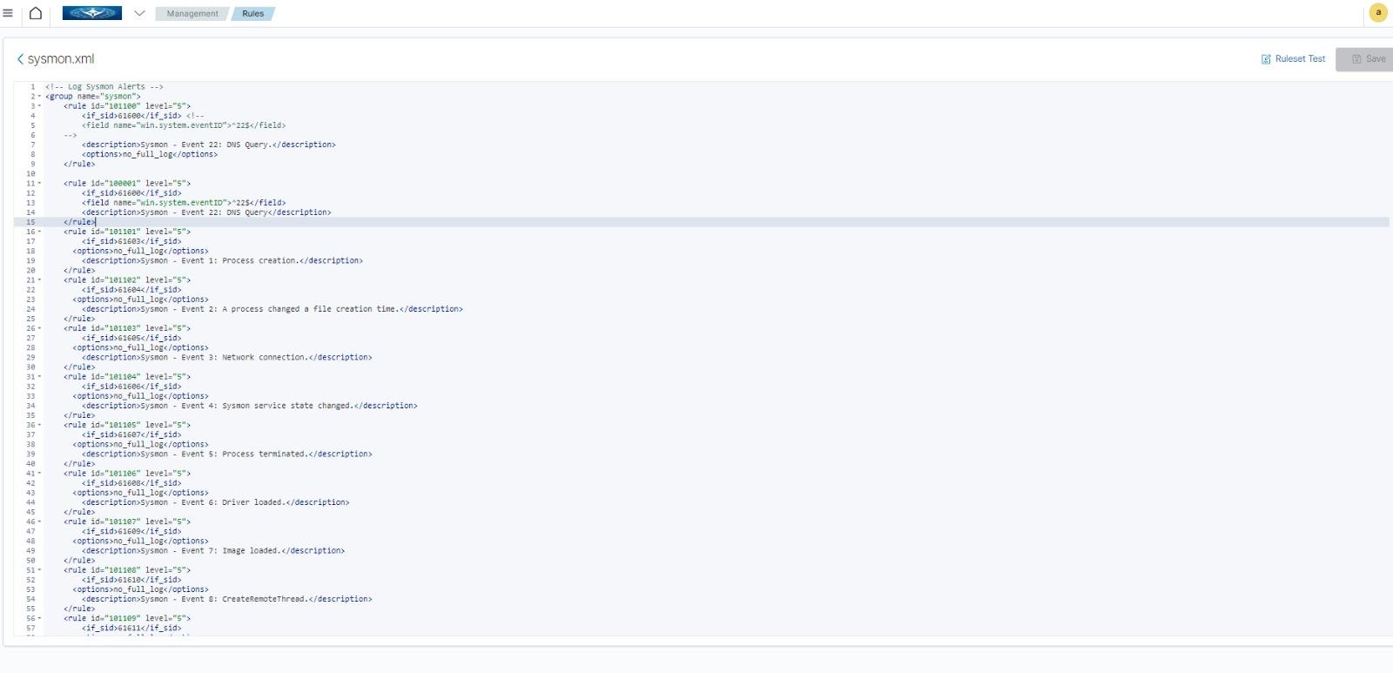

Slide 10
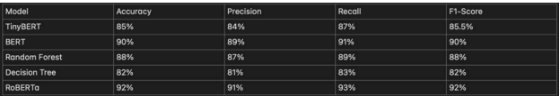
Results
Model Comparison: The hybrid model's performance is compared with other baseline models, including variants of BERT and decision tree models. Metrics like accuracy, precision, recall, and F1-score are utilized, with the hybrid model showing superior performance overall.
Performance Analysis: The hybrid model's performance is analyzed, achieving an accuracy of 99.16%, indicating high effectiveness in phishing detection. Precision, recall, and F1-score metrics further demonstrate the model's capability in minimizing false positives and false negatives.
Key Metrics: The hybrid model's performance is summarized with key metrics: Accuracy at 99.13%, F1 Score of 0.99, and Recall at 0.99, highlighting its robustness in detecting phishing emails.

Slide 11
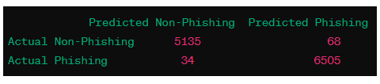
Results
Accuracy: 99.13%
F1 Score: 0.99
Recall: 0.99
Confusion Matrix:

Slide 12
Conclusion
Project Recap: This project highlights the effectiveness of utilizing a hybrid machine learning model and integrating with SIEM solutions for phishing email detection. By combining a Random Forest classifier for metadata features and a RoBERTa model for text embeddings, the hybrid model achieves high accuracy and robust performance.
Final Thoughts: The integration of the trained model into a Flask API and its deployment in a SIEM solution like Wazuh provides a comprehensive solution for real-time phishing detection. Implementing real-time data processing mechanisms ensures seamless detection. Advanced feature engineering, such as considering the presence of URLs, further enhances the model’s accuracy in identifying phishing emails.
Potential Future Research: Future work could focus on incorporating additional features and improving the model’s performance on larger and more diverse datasets.

Slide 13
References
1. Myneni, Sowmya, Ankur Chowdhary, Abdulhakim Sabur, and Myong H. Kang. “DAPT 2020
-Constructing a Benchmark Dataset for Advanced Persistent Threats.” ResearchGate, July
31, 2020.
https://www.researchgate.net/publication/343332799_DAPT_2020_-Constructing_a_Benchm
ark_Dataset_for_Advanced_Persistent_Threats.
2. S. Kim, J. Lee, and J. Kim, "A machine learning-based approach to detect advanced
persistent threats," Journal of Information Security and Applications, vol. 39, pp. 1-10, 2018.
3. Y. Zhang, X. Zhang, and Y. Liu, "Deep learning-based detection of advanced persistent
threats using system call traces," Journal of Computer and System Sciences, vol. 89, pp.
1-11, 2018.
4. S. Lee, J. Kim, and J. Kim, "A hybrid approach for detecting advanced persistent threats
using machine learning and rule-based techniques," Journal of Network and Computer
Applications, vol. 116, pp. 1-10, 2018.

Slide 14
4. S. Lee, J. Kim, and J. Kim, "A hybrid approach for detecting advanced persistent threats
using machine learning and rule-based techniques," Journal of Network and Computer
Applications, vol. 116, pp. 1-10, 2018.
5. Ghafir I, Hammoudeh M, Prenosil V, et al. Detection of advanced persistent threat using
machine-learning correlation analysis. Future Gener Comput Syst. 2018; 89: 349-359.
6. Waqas M, Kumar K, Laghari AA, et al. Botnet attack detection in Internet of Things devices
over cloud environment via machine learning.. Concurr Comput. 2022; 34(4): 1-23.
7. Leevy JL, Khoshgoftaar ,TM. A survey and analysis of intrusion detection models based on
CSE-CIC-IDS2018 big data. J Big Data. 2020; 7(1): 1-19.
8. Ayachi Y, Mellah Y, Berrich J, Bouchentouf T. Increasing the performance of an IDS, using
ANN model on the realistic cyber dataset CSE-CIC-IDS2018. International Symposium on
Advanced Electrical and Communication Technologies (ISAECT). IEEE; 2020: 1-4.
9. Burt J. McAfee finds years-long attack by Chinese-linked APT groups.
https://www.esecurityplanet.com/threats/mcafee-finds-years-long-attack-by-chinese-apt-grou
ps

